Slide 1
Axial Flux Permanent Magnet Machine with
Novel Flat Winding
Made of Conductor Sheet
Gökhan Çakal
MSc Thesis Defense
METU, Department of Electrical and Electronics Engineering Ankara, TURKEY
September 2020
Notes:
Dear professors and collagues

Slide 2
Outline
Flat winding and implementation on AFPM
Analytical modeling
Experimental verification
1 MW wind turbine generator
Conclusions

Slide 3
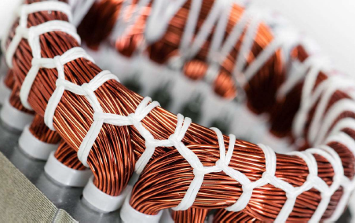
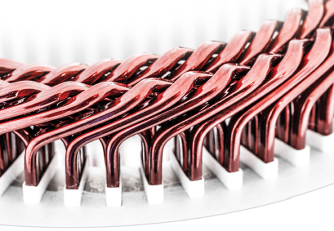
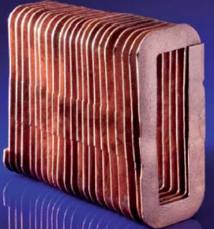
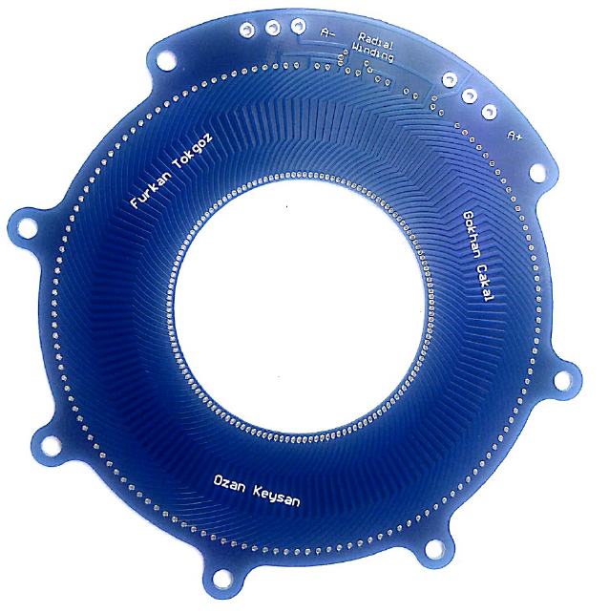
Existing Winding Topologies
Conventional stranded round wires
Hairpin winding
Cast produced winding
PCB winding
[1]
[2]
[3]
Merits | Low eddy current loss | Fill factor Superior current | Easy to manufacture | Easy to manufacture
Challenges | Limited current density (5-6 A/mm²) Low current rating Manufacturing | Eddy current loss High cost Manufacturing | Eddy current loss High cost | High cost Low current ratings Low power
Notes:
Current density under air cooled 5-6 A/mm2
Manufacturing için winding machine gerekli
Parallel connections

Slide 4
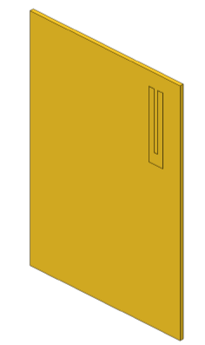

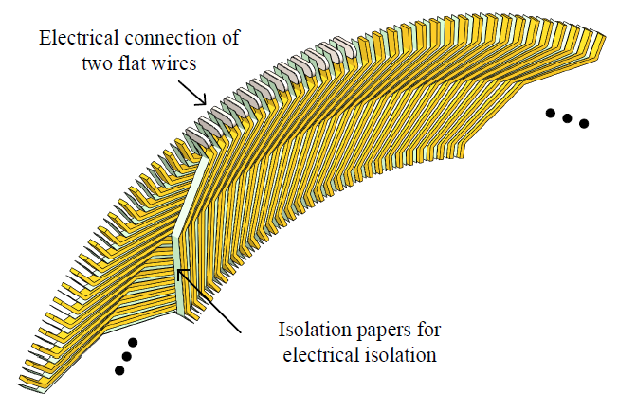
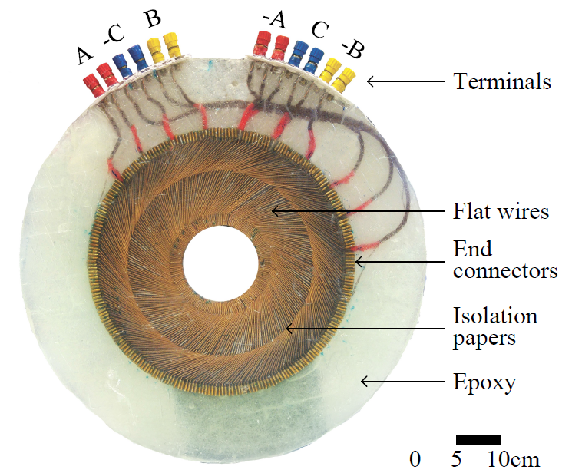
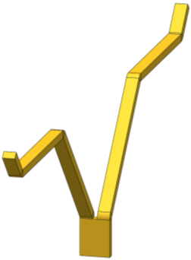
Proposed Solution: Flat Winding⁴
Take a thin conductor sheet
Cut pieces with
Stamping press
Laser cutter
Water jet
Bend them
Place isolation papers between flat wires
Solder end windings
Mold with epoxy
Create terminals
[4] G. Cakal and O. Keysan, (2019). Elektrik Makinaları İçin Bir Sargı Yöntemi (Patent Pending). Türk Patent.
Notes:
Patent pending
Gercek flat wire goster

Slide 5
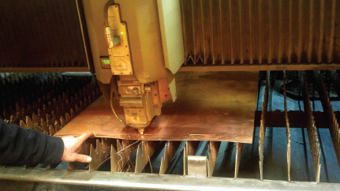
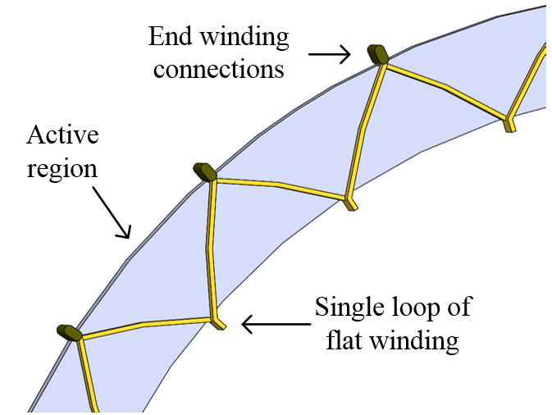
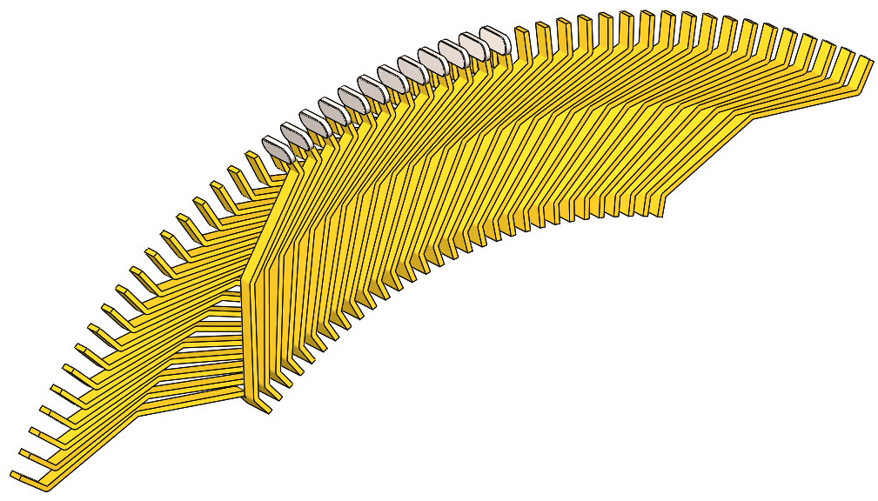
Merits and Challenges of Flat Winding
Merits
Challenges
Ease of manufacturing
Commonly used tools
High current density
7 A/mm² under natural cooling
Superior current ratings
Eliminating parallel connection
Decreased end winding length
Reduced end winding losses
Laser cutting of copper sheet
Flux passing direction
End winding connections

Slide 6
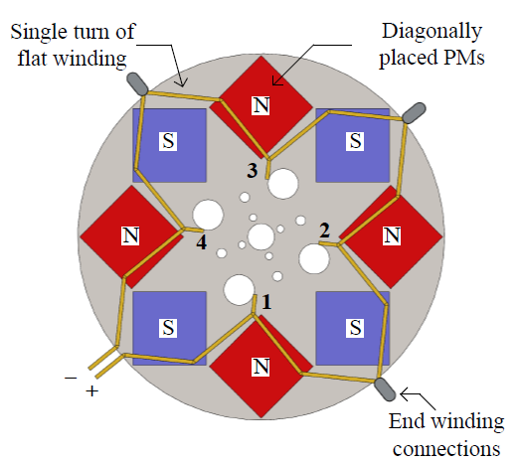
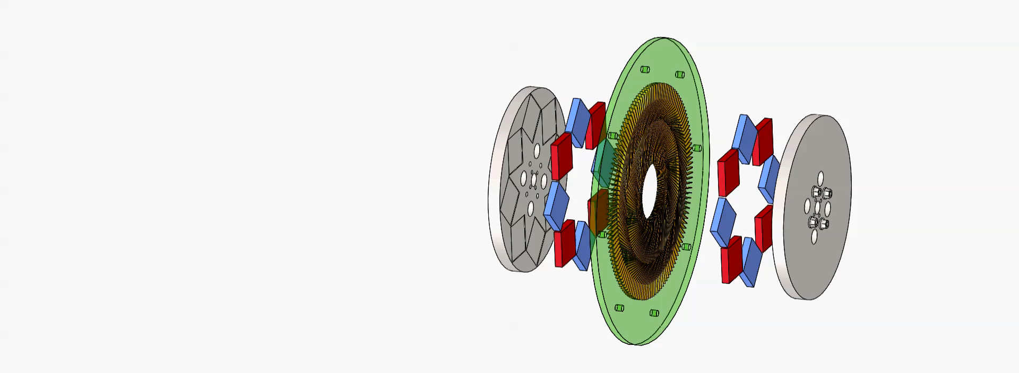
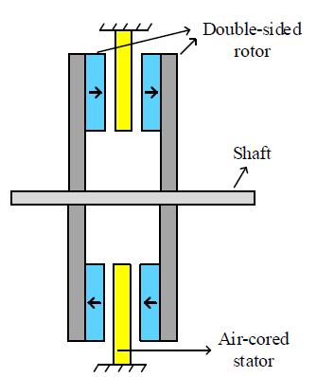
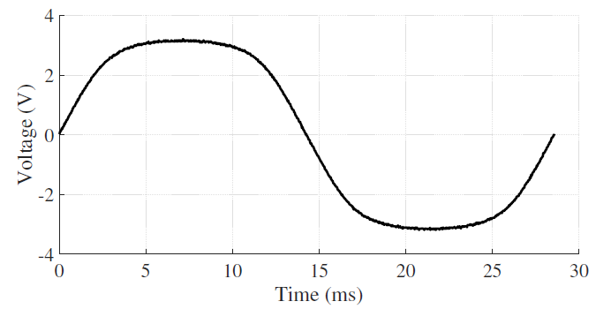
Implementation on AFPM
Topology advantages
Air cored stator
No attraction between rotor and stator
Eliminated cogging torque
Better demagnetization performance
Low magnetic loading
Stackable in the axial direction
Multi-staged designs
Increased modularity
Eliminated AC losses on rotor
Except ones due to armature reaction
The proposed topology
Single turn of flat winding with rotor
Induced voltage on the flat winding
Notes:
Topolojiyi anlat
AFPM, double rotor single stator, sandwiched
Diagonal placement
N42M grade magnets

Slide 7
Outline
Flat winding and implementation on AFPM
Analytical modeling
Experimental verification
1 MW wind turbine generator
Conclusions

Slide 8
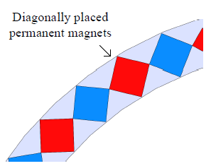
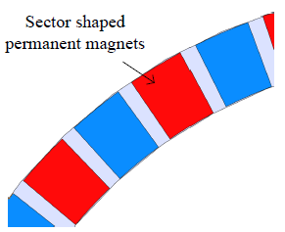
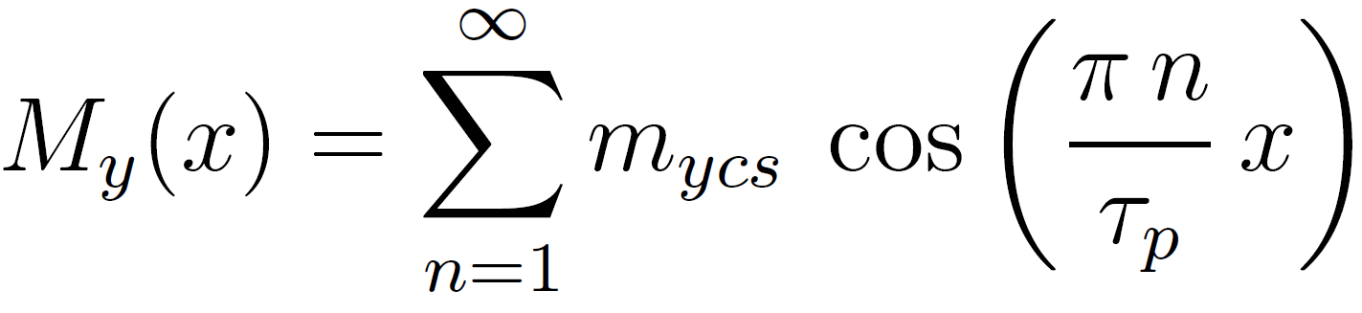
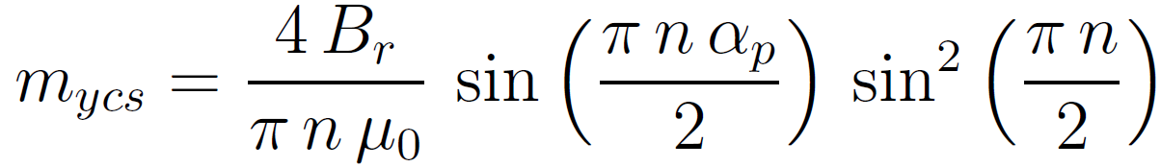
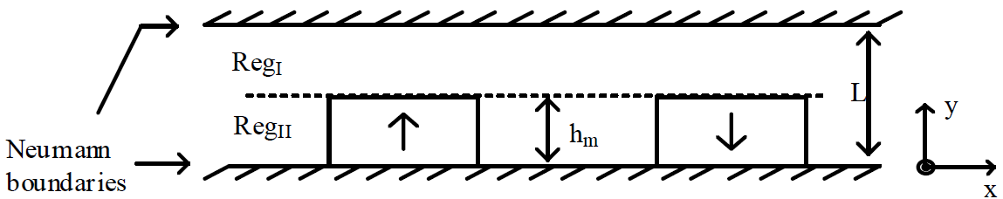
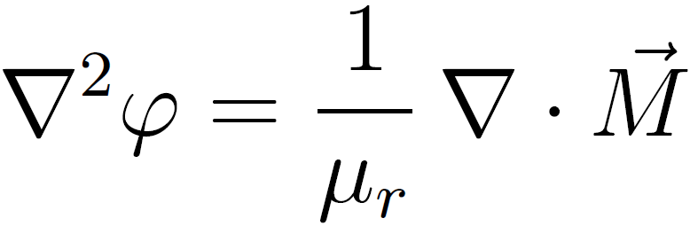
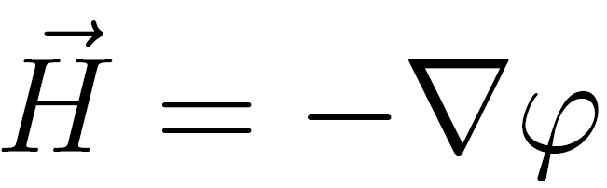
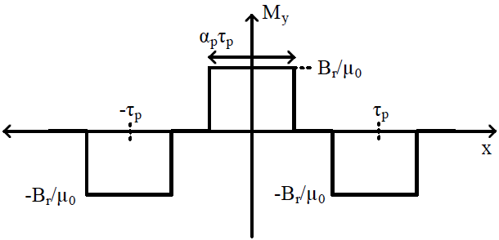
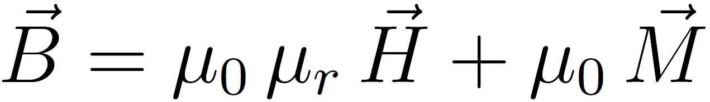
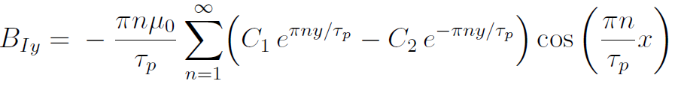
Magnetic Field Modeling
Magnet approximation
Field modeling
Magnetization of the magnets
[5,6]
Notes:
No-load magnetic field
Magnetic scalar potential with the help of Fourier series, Laplace eqns and boundary cd
2D representation of the model is needed, thus magnet approximation
Field derivation steps
Fourier representation of the permanent magnets
Laplacian of magnetic scalar potential = 1/mr * divergence of magnetization vector
At both regions, laplacian of magnetic scalar potential is zero
In air region, there is no magnetization source
In magnet region, there is only y-component, which depends on x-variable, thus, divergence of magnetization is zero
The solution is governed by laplace equation
H (magnetic field intensity) is minus gradient of magnetic scalar potential
B (flux density) is related to H via constitutive relation
Solve unknowns with boundary conditions
No magnetic field beyond Neumann boundaries
B normal and H tangential are continious at boundaries
Solve the equation in MATLAB with matrix inversion tool and obtain the field.

Slide 9
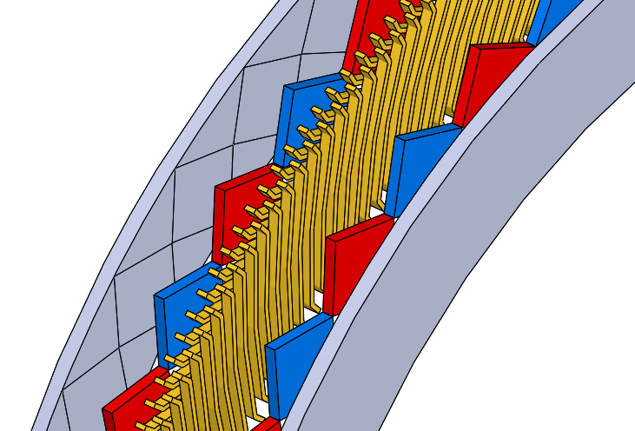
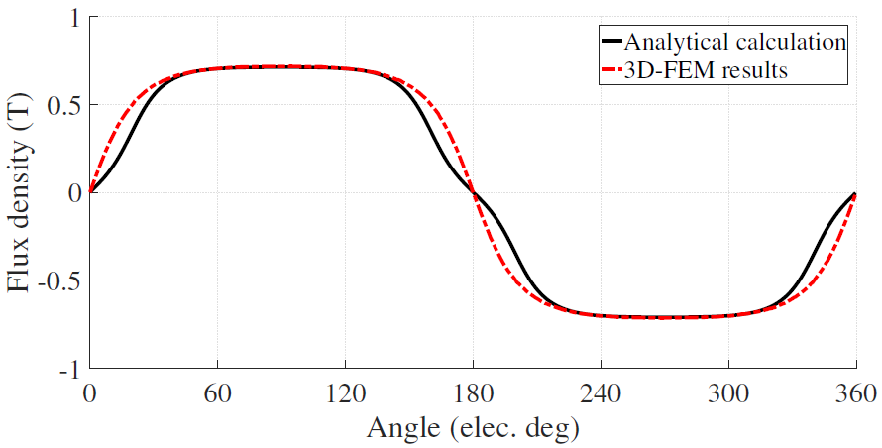
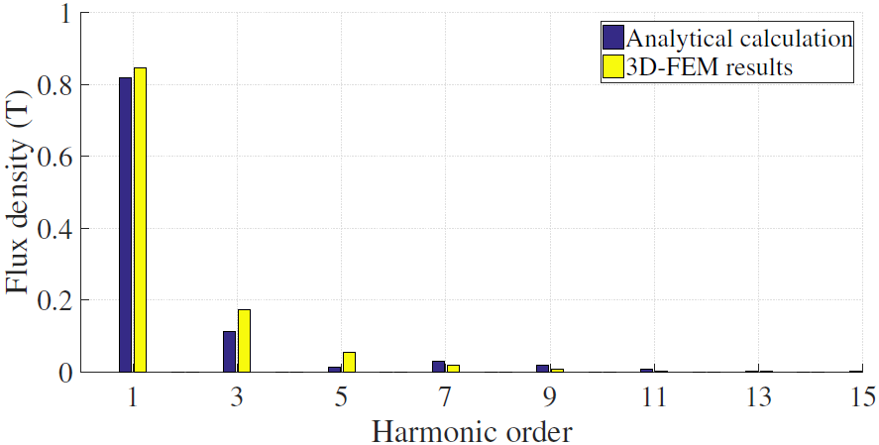
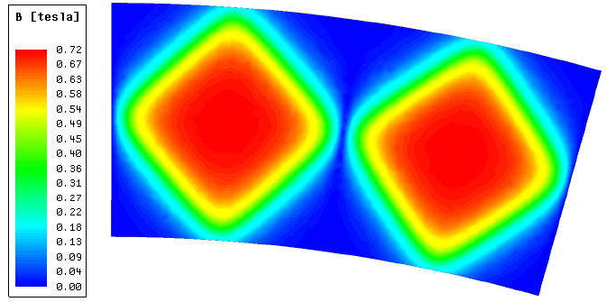
Magnetic Field Modeling
Verification by FEA
Parameters | Value
Rated power | 1 MW
Rotational speed | 20 rpm
Diameter | 4.8 m
Number of poles | 46
Magnet grade | N42M
Remanence flux density | 1.29 T
Magnet thickness | 36.5 mm
Magnet to magnet distance | 47.3 mm
Dummy machine for field verification
3%
Magnetic flux density distribution by FEA

Slide 10
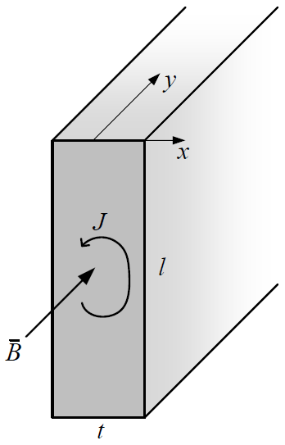
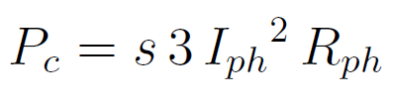
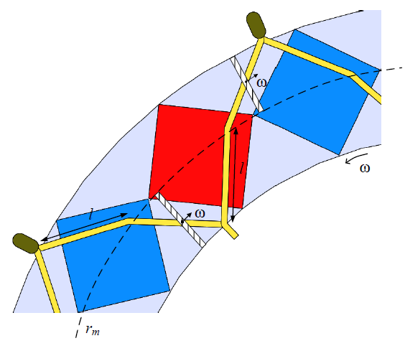
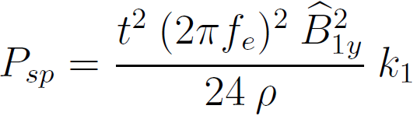
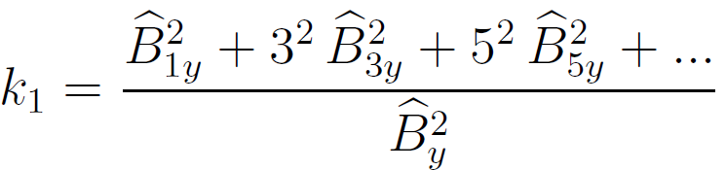
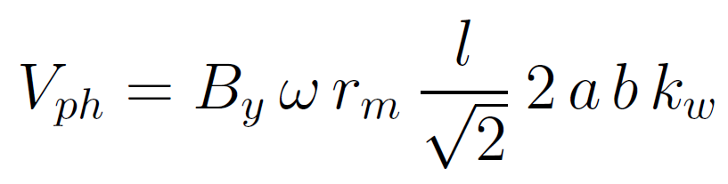
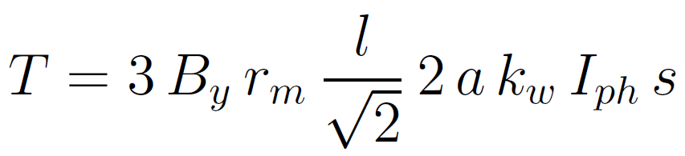
Other Parameters
Induced voltage and torque
Conduction and eddy current losses
[7]
 | Conduction loss | Eddy current loss
Analytical model | 75.54 kW | 33.17 kW
FEA | 75.56 kW | 31.39 kW
<0.1%
5.7%
Notes:
Peddy α t², f², B², 1/res

Slide 11
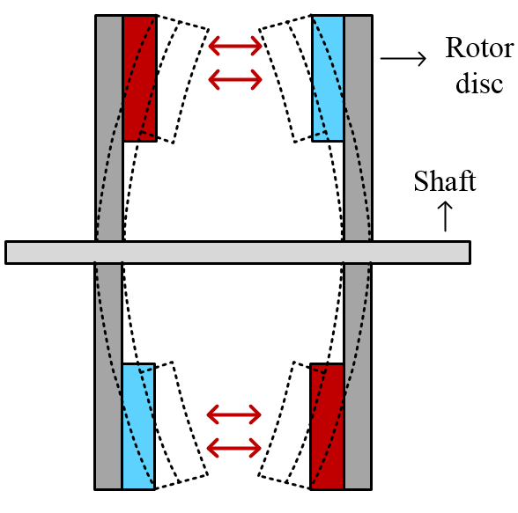
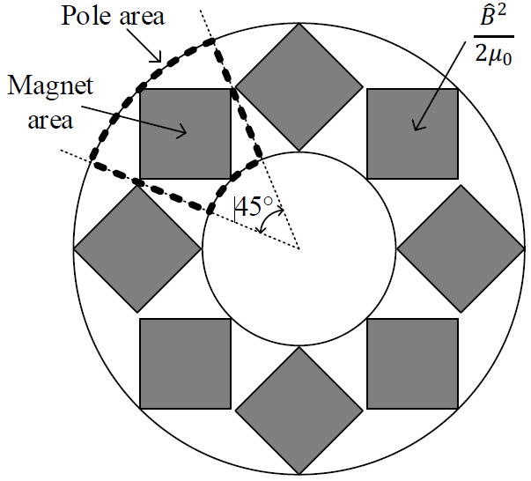
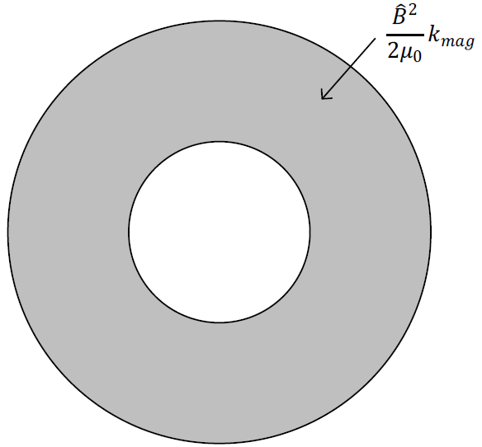
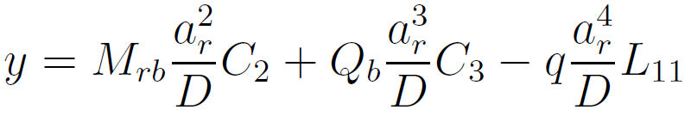
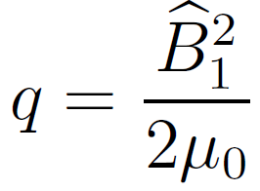
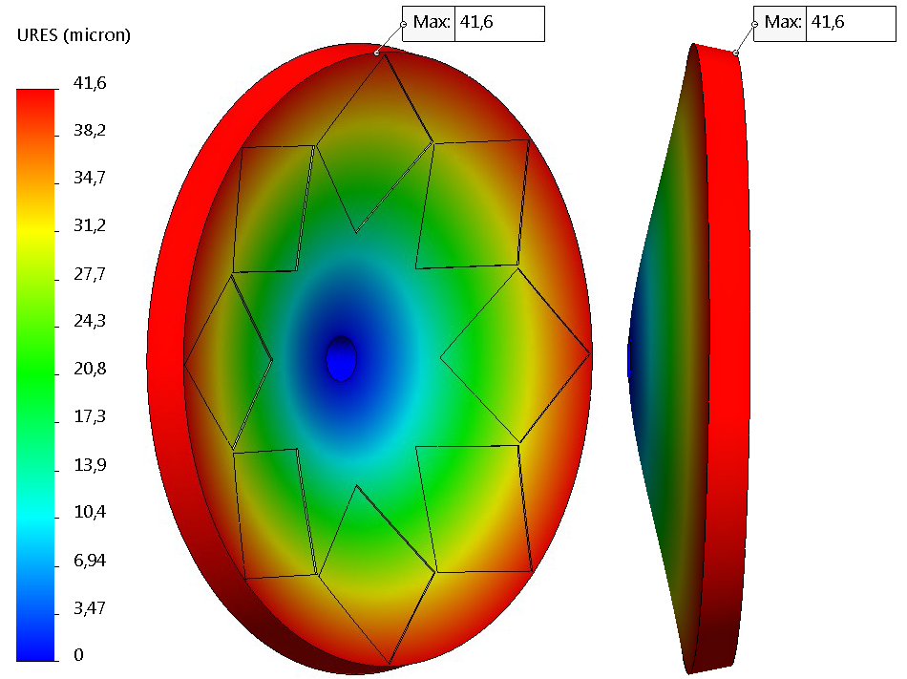
Deflection Analysis
[8]
Deflection of rotor cores
Stress distribution approximation
Deflection analysis comparison
Dummy machine for deflection verification
 | Deflection | Percentage of clearance
Analytical model | 40.4 µm | 1.76 %
FEA | 41.6 µm | 1.81 %
Parameters | Value
Peak flux density | 0.87 T
Outer diameter | 300 mm
Air gap clearance | 2.3 mm
Deflection analysis by FEA
3%
[8] W. C. Young and R. G. Budynas, Roark’s formulas for stress and strain; 7th ed. McGraw Hill, 2002.
Notes:
The reason of deflection and deflection analysis onemi
Bending of the rotor cores
Mechanical problems - non-linearities in the magnetic model
Allowed deflection is 5-10% of the air gap clearance
Circular plate theory
Constant and uniform stress distribution
Mrb = unit radial bending moment
D = plate constant
Qb = shear force on the shaft
q= stress
FEA by SolidWorks on prototype machine
Resultant deflection = 2 %

Slide 12
Outline
Flat winding and implementation on AFPM
Analytical modeling
Experimental verification
1 MW wind turbine generator
Conclusions

Slide 13
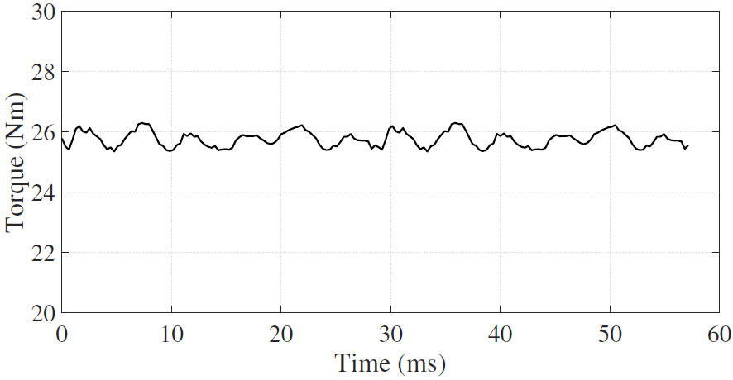
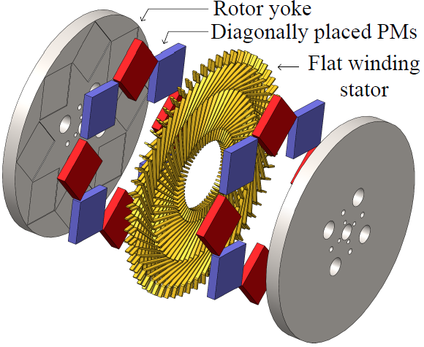
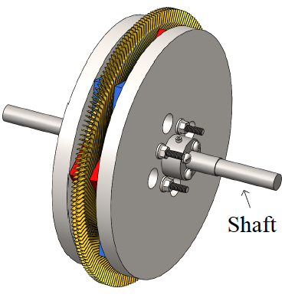
Genetic Algorithm Optimization
Fully analytical optimization on MATLAB
Objective function of minimizing active mass
Optimization variables of
Outer diameter
Magnetic loading
Population and generation sizes of 50, both
[9]
Parameters | Value
Rated power | 1.4 kW
Line voltage | 48 V
Current | 20 A
Rotational speed | 525 rpm
Rated torque | 26 Nm
Pole number | 8
Frequency | 35 Hz
Outer diameter | 300 mm
Current density | 4 A/mm²
Magnetic loading | 0.6 T
Conduction loss | 110 W
Eddy current loss | 53 W
Efficiency | 89%
Active mass | 29 kg
Air gap clearance | 2.3 mm
Flat wire dimensions | 1 x 5 mm
Optimized prototype machine
[9] G. Cakal and O. Keysan, ‘‘A novel flat winding made of aluminum or copper sheet for axial flux machines,’’ IET Electric Power Applications, (Review), 2020.
Notes:
IET Electric Power Applications
Table comments
1.4 kW, 48 V and 20 A
Relatively low voltage and high current
8 pole with 35 Hz frequency
4 A/mm2
Conduction > Eddy
Due to thin conductor sheet
Stacking through thickness
Optimization constraints (sorarlarsa)
Line voltage 48V
Current density 4A/mm²
Pole number 8
Remanence flux density 1.39 T
Air gap clearance 2.3 mm
Flat wire thickness 1 mm
Efficiency > 80%
Frequency <100 Hz

Slide 14

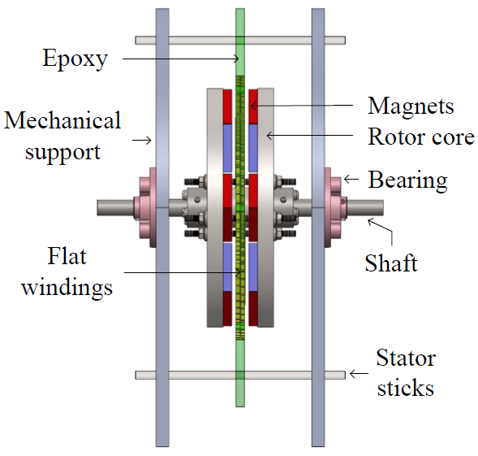
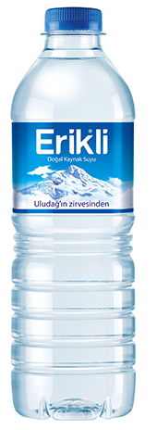
Mechanical Design
Mechanical design
Assembling process
Mechanical design of the prototype
Assembly of the prototype
Notes:
SolidWorks is used

Slide 15
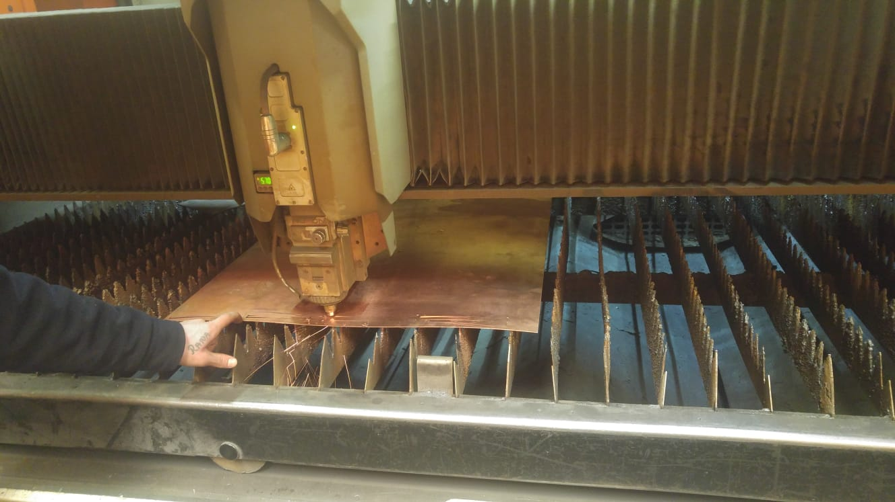
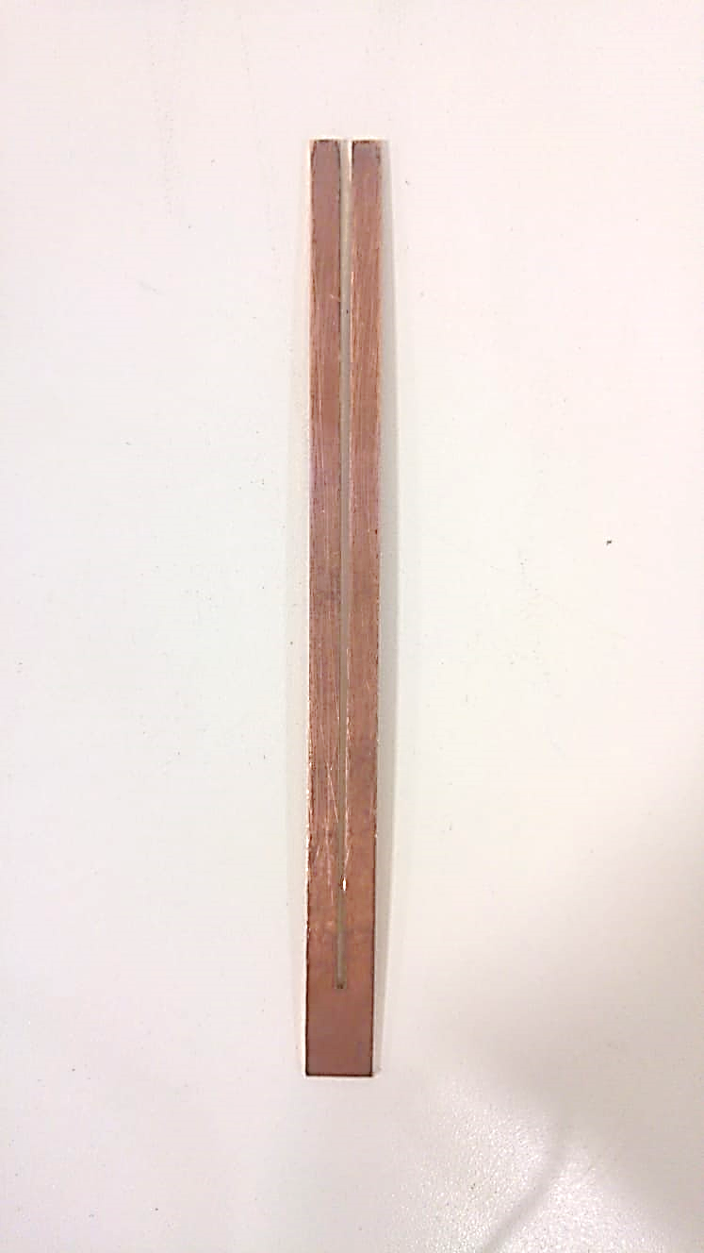
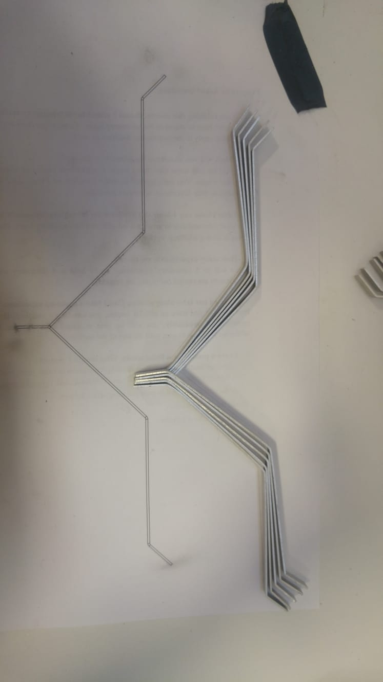

Manufacturing Stages
Laser cutting of copper sheet
Cut pieces
Bending of flat wires
Flat wire placement
Notes:
Laser is used. Stamping press can be used also.
1 mm copper and aluminum thickness

Slide 16




Manufacturing Stages
Copper flat wires
Isolation paper
Aluminum flat wires with isolation papers
Connectors at end winding
Notes:
240 flat wires are used
240 end winding soldering is done
For copper soldering is enough
For aluminum advanced solutions are needed

Slide 17




Manufacturing Stages
Aluminum flat winding stator with terminals
Copper flat winding stator with terminals
Glass fiber in epoxy molding
Epoxy molding
Notes:
Thermocouples for temperature measurement
Cam elyaf = glass fiber

Slide 18




Manufacturing Stages
Epoxy molding
Stator inside the mold
Final form of the stator
Thermal testing
Notes:
Epoxy molding
-high thermal conductivity
-low viscosity (akmaya karsi direnc)
-high mechanical strength

Slide 19




Manufacturing Stages
ST52 rotor steel
Magnet guides on rotor disc
Assembling magnets with rotor core
Safe fingers after assembly
Notes:
ST52 steel with Br 1.9 T
N42M NdFeB magnets

Slide 20




Manufacturing Stages
Water jet cutting of mechanical structure
Assembling of two rotor discs
The prototype
Experimental setup
Notes:
No forced cooling
Setup
Run as generator
Loaded by three phase resistor bank
Input power, torque and speed measured by torque transducer
Output power measured by wattmeter

Slide 21




Experimental Results
Open circuit characteristics
Loading test
Eddy current and friction losses
Induced voltages
Voltage and current measurements
Eddy current and friction loss variation against speed
Full load, 26 Nm
Half load,13 Nm
Current harmonics due to unbalanced resistive load
At rated operation
55 W of eddy current loss
8 W of friction loss
2%
Harmonics of induced voltages
Eliminated 3rd harmonics
Notes:
OC test
Rotated with prime mover
No-load 525 rpm
Loading test
4.6 % drop in voltage due to armature resistance
Eddy current and friction losses
Measured at rated speed
Friction loss measured without stator
No load losses=friction+eddy
Eddy exponential increase with square as expected

Slide 22

Experimental Results
Losses and efficiency measurement
Thermal characteristics
 | Analytical model | Experimental result
Eddy current loss | 53 W | 55 W
Conduction loss | 110 W | 117 W
Phase resistance | 93 mΩ | 100 mΩ
Efficiency | 89 % | 88 %
4%
32 °C
6%
17 °C
Temperature measurement over time
63 W eddy and friction
117 W conduction (4 A/mm²)
63 W eddy and friction
359 W conduction
ΔT = 32 °C
ΔT = 75 °C
7 A/mm² for flat wire under natural cooling
Notes:
Losses and efficiency measurement
Under rated operation
Eddy current loss difference due to 2% field error
Conduction loss difference due to cable resistance of measurement devices (20A)
Thermal characteristics
Winding temperature only
Ambient temperature of 27 C

Slide 23



Copper vs. Aluminum Flat Winding
Copper
Aluminum
Eddy current losses
Merits | 63% more conductive | 70% lighter 70% cheaper
Challenges | High eddy current losses | Welding/soldering
The variation of eddy current loss against speed
[7]
Notes:
Feasibility of aluminum
Aluminum is not common in stranded round wires because conduction > eddy
For flat wire, cross sectional area ↑, AC losses ↑ so investigate the aluminum
Al is 70% cheaper per mass
Both are manufactured for the prototype machine
Copper → simple soldering
Aluminum → TIG welding, laser welding, ultrasonic welding, spot welding(punto), tin plating then soldering
Resistivity ↑, skin depth ↑, AC losses ↓

Slide 24





Copper vs. Aluminum Flat Winding
Copper
Aluminum
Material selection
Loss variations on torque speed plane
Copper
Aluminum
Rated speed
(525 rpm)
High
speed
(1000 rpm)
Rated speed
(525 rpm)
High
speed
(1000 rpm)
Conduction
110 W
31 W
185 W
49 W
losses
Higher efficiency
Eddy current
53 W
199 W
34 W
124
W
Higher efficiency
loss
+33%
-23%
Total losses
171
W
246
W
227
W
189
W
Efficiency
89.3%
-70%
85.3%
86.3%
88.3%
Winding mass
3.56 kg
1.08
kg
Efficiency maps
Material cost
$ 170
-93%
$ 12
Notes:
Total losses including conduction and eddy current losses
Material selection
Experimentally verified at crossed points
At rated operation, copper is favorable
Case study table
Rated power of 1.4 kW both

Slide 25






Demagnetization Analysis
Finite element analysis
Analytical results
-d axis current
80 °C operating temperature
Observation points inside magnet
Short circuit at the terminals
Demagnetization curve of a PM
Direct and quadrature axes
800 A
Demagnetization curve of PM at different currents
No risk of demagnetization for the prototype
Notes:
Purpose of demagnetization analysis
Safe and reliable operation especially in field weakening
Air cored → reluctance high → inductance low → large sc current
Demagnetization sources
Large reverse magnetic field
High temperature
Aging of the magnet itself
No demagnetization risk
- Expected since low voltage and high current

Slide 26
Outline
Flat winding and implementation on AFPM
Analytical modeling
Experimental verification
1 MW wind turbine generator
Conclusions

Slide 27

Mechanical Design and Optimization
Mechanical design
Genetic algorithm optimization
Constraints
Parameters | Value
Rated power | 1 MW
Rated speed | 20 rpm
Efficiency | > 90%
Line voltage | < 690 V
[10]
Preferred mechanical models
Variables
Shortened lever arm
Less deflection
Decreased structural mass
Increased torque density
Increased modularity
Parameters | Value
Diameter | 2 m – 13 m
Flat wire width | 5 mm – 50 mm
Flat wire thickness | 1 mm – 10 mm
Number of poles | 10 – 160
Current density | 1 A/mm2 – 9 A/mm2
Number of stages | 1 – 14
Number of parallel turns | 1 – 8
Objective function
min(total mass)
Notes:
The aim of the study
Observe the flat winding in MW-class machines
By upscaling the proposed models
Selected application
- Direct-drive axial flux wind turbine generator
The importance of structural mass estimation
- Diameter ↑, active mass ↓, structural mass ↑

Slide 28



Genetic Algorithm Optimization
Feasibility
[11]
Parameters | Value
Rated power | 1 MW
Torque | 480 kNm
Rotational speed | 20 rpm
Diameter | 4.8 m
Number of stages | 2
Voltage | 680 V
Current | 850 A
Active mass | 10.4 t
Structural mass | 5.6 t
Total mass | 16.0 t
Efficiency | 90 %
Number of poles | 46
Frequency | 7.7 Hz
Current density | 3.8 A/mm²
Flat wire dimensions | 3 x 18.6 mm
Total cost | € 203k
Conduction loss | 75 kW
Eddy current loss | 31 kW
Copper sheet
x 63
Cost analysis
Material cost | € 45k
Laser cutting | € 1.2k
Water jet | € 8.5k
Optimized 1 MW generator
[11] G. Cakal and O. Keysan, ‘‘Axial flux generator with novel flat wire for direct-drive wind turbines,’’ IET Renewable Power Generation, (Accepted), 2020.
Notes:
Table comments
Double stage, 1 MW 480 kNm with 4.8 m diameter
Total mass of 16 tons
Efficiency and voltage converged close to their limits
Current density 3.8 A/mm², proven to be safe.
Around € 200k (two hundred thousand)
More cost-effective solutions when the cost is added to objective fcn
Feasibility
92 flat wires per sheet
Stamping press can decrease the cost further
Faster

Slide 29
Comparison
 | Li et al. [12] | This study | McDonald et al. [13] | Maples et al. [14] | Versteegh [15] | Bang [16]
Generator type | RFPM | AFPM | AFPM | RFPM | RFPM | RFPM
Power | 0.75 MW | 1 MW | 1 MW | 1 MW | 1.5 MW | 2 MW
Speed | 29 rpm | 20 rpm | 12 rpm | 26 rpm | 18 rpm | 20 rpm
Torque | 250 kNm | 477 kNm | 798 kNm | 367 kNm | 796 kNm | 979 kNm
Number of stages | 1 | 2 | 4 | 1 | 1 | 1
Active mass | 3.1 t | 10.4 t | 18.6 t | - | 16.7 t | 14.6 t
Structural mass | - | 5.6 t | 6.9 t | - | 20.8 t | 10.4 t
Total mass | - | 16.0 t | 25.5 t | 17.4 t | 37.5 t | 25.0 t
Torque density by active mass | 79.7 Nm/kg | 46.0 Nm/kg | 42.9 Nm/kg | - | 47.7 Nm/kg | 67.0 Nm/kg
Torque density by total mass | - | 29.8 Nm/kg | 31.3 Nm/kg | 21.0 Nm/kg | 21.2 Nm/kg | 39.2 Nm/kg
Notes:
Comments
Generators with power range 0.75 MW – 2 MW
The performance is compared in terms of torque density in Nm/kg
Not all publications have mass data
Two definitions of torque density
˷30 Nm/kg is compatible with other generators
The main advantage
Ease of manufacturing
The advantages of air cored design

Slide 30





Thermal Analysis
Actual model
Improved model
ΔT = 90 °C
ΔT = 40 °C
Partially coated epoxy
Increased surface area
Decreased thermal resistance
Flat winding stator of the generator
SolidWorks simulation
106 kW heat power
75 kW conduction loss
31 kW eddy current loss
50 W/(m²K) convection
Air cooling
Full coating of the windings
Partial coating of the windings
66% increase in electrical loading
Notes:
On SolidWorks
Actual model
28 C ambient
118 C max temperature
3.8 A/mm² safe
Improved model
Thermal conductivity
Copper = epoxy x 40
Direct contact to air
Less than half of temperature rise of actual model
Thermal conductivity
Copper 400 W/(mK)
Epoxy 1-10 W/(mK)
Water 0.6 W/(mK)

Slide 31
Outline
Flat winding and implementation on AFPM
Analytical modeling
Experimental verification
1 MW wind turbine generator
Conclusions

Slide 32
Conclusions
 | Flat winding | Conventional round winding | Hairpin winding | PCB winding
Ease of manufacturing | ++ | + | + | ++
Current density | ++ | - | + | ++
Current rating | ++ | + | ++ | -
Manufacturing cost | + | + | - | --
End winding loss | ++ | + | - | +
Eddy current loss | + | ++ | - | +
Boosted machine performance
Ease of manufacturing
Current density up to 7 A/mm2
Shortened end windings
Lower end winding losses
Experimental verification on 1.4 kW prototype
Good agreement with analytical and FEA results
Elimination of eddy current losses
Thin flat wire
Stacking through thickness
Aluminum alternative
At high speed operation
Cost and weight advantages
Performance on MW-class
Comparable torque density
Notes:
Conventional windings may lack at some points
Alternative winding is needed
Table + first bullet
Ease of manufacturing
Laser cutter / stamping press
Higher current density (7 A/mm²)
High current rating
Shortened end windings
Implementation on axial flux machine
High torque density
No cogging torque

Slide 33
References
[1] Taizhou Chuangpu Machinery and Electricity, “Basic knowledge of stator winding.” www.ixymotor.com, Accessed: 2020-08-19.
[2] Special Machine Tool, “Hairpin winding technology.” www.specialmachinetool.it. Accessed: 2020-08-19.
[3] Fraunhofer-Institute for Manufacturing Technology and Advanced Materials, "Coils produced by casting.” www.generativ.fraunhofer.de. Accessed: 2020-08-19.
[4] G. Cakal and O. Keysan, (2019). Elektrik Makinaları İçin Bir Sargı Yöntemi (Patent Pending). Türk Patent.
[5] Z. Q. Zhu, D. Howe, E. Bolte, and B. Ackermann, “Instantaneous magnetic field distribution in brushless permanent magnet DC motors. I. open-circuit field,” IEEE Transactions on Magnetics, vol. 29, pp. 124–135, Jan 1993.
[6] E. P. Furlani, “Computing the field in permanent-magnet axial-field motors,” IEEE Transactions on Magnetics, vol. 30, pp. 3660–3663, Sep. 1994.
[7] G. Muller, K. Vogt, and B. Ponick, Wicklungen Rotierender Elektrischer Maschinen. John Wiley & Sons Ltd., 2009.
[8] W. C. Young and R. G. Budynas, Roark’s formulas for stress and strain; 7th ed. McGraw Hill, 2002.
[9] G. Cakal and O. Keysan, ‘‘A novel flat winding made of aluminum or copper sheet for axial flux machines,’’ IET Electric Power Applications, (Review), 2020.
[10] M. A. Mueller and A. S. McDonald, “A lightweight low-speed permanent magnet electrical generator for direct-drive wind turbines,” Wind Energy, vol. 12,no. 8, pp. 768–780, 2009.
[11] G. Cakal and O. Keysan, ‘‘Axial flux generator with novel flat wire for direct-drive wind turbines,’’ IET Renewable Power Generation, (Accepted), 2020.
[12] H. Li, Z. Chen, and H. Polinder, “Optimization of multibrid permanent-magnet wind generator systems,” IEEE Transactions on Energy Conversion, vol. 24, pp. 82–92, March 2009.
[13] A. S. McDonald, N. Al-Khayat, D. Belshaw, M. Ravilious, A. Kumaraperumal,A. M. Benatamane, M. Galbraith, D. Staton, K. Benoit, and M. Mueller, “1MW multi-stage air-cored permanent magnet generator for wind turbines,” 6th IET International Conference on Power Electronics, Machines and Drives (PEMD 2012), pp. 1–6, 2012.
[14] B. Maples, M. Hand, and W. Musial, “Comparative assessment of direct drive high temperature superconducting generators in multi-megawatt class wind turbines,” Technical Report,National Renewable Energy Laboratory, pp. 1–40, 10 2010.
[15] C.Versteegh, “Design of the zephyros Z72 wind turbine with emphasis on the direct drive PM generator,” Nordic Workshop on Power and Industrial Electronics, pp. 1–7, 2004.
[16] D. Bang, Design of Transverse Flux Permanent Magnet Machines for Large Direct-Drive Wind Turbines. Phd dissertation, Delft University of Technology, Delft, The Netherlands, October 2010.

Slide 34
Thanks!

Slide 35



Additional Slides
Hot spot due to weak soldering
Temperature rise at different operating conditions

Slide 36
Current Density Calculation
55 W eddy
8 W friction
117 W conduction
180 W total
ΔT = 32 °C
359 W conduction
55 W eddy
8 W friction
ΔT = 75 °C
422 W total
J = 4 A/mm²
117 W conduction
J = 7 A/mm²
359 W conduction

Slide 37



Demagnetization Analysis
Finite element analysis
Analytical results
-d axis current
80 °C operating temperature
Observation points inside magnet
Short circuit at the terminals
Risk of demagnetization
Demagnetization curve
2.5 kA
Use H or UH grade magnets
80 °C approximation
Notes:
Risk of demagnetization
Unlike the prototype

Slide 38
Cost Analysis
 | Prototype machine | MW-turbine
Permanent magnets | € 320 | € 135k
Winding material | € 170 | € 45k
Rotor iron | € 45 | € 11k
Structural material | € 5 | € 12k
Total | € 540 | € 203k
 | Specific cost
Magnet | 60 €/kg
Copper | 15 €/kg
Rotor iron | 2 €/kg
Structural steel | 2 €/kg
Notes:
Risk of demagnetization
Unlike the prototype

Slide 39

Diagonal Placement
Diagonal magnet placement

Slide 40












Optimization
Flat wire thickness variation
Diameter variation
Notes:
In order to understand the tradeoffs between machine parameters, the outer diameter of the generator is fixed and an optimization study is conducted to find the optimum design. This procedure is repeated for seven different outer diameters from 2m to 8m. The optimum designs are obtained for each diameter and following results are obtained.
Procedure
The outer diameter is fixed
Seven optimization problems are solved
Diameter variation
Diameter ↑, lever arm ↑, PM mass ↓
Active mass ↓, structural mass ↑
Minimum mass around 5m
Importance of adding structural mass
Cost α PM mass → diameter ↑, cost ↓
Diameter ↓, induced volt ↓ (due to reduced linear speed) → multistage designs, → axial length↑
Flat wire thickness variation
Efficiency constraint → constant total loss
Thickness ↑, eddy loss ↑, conduction ↓
To limit eddy loss, frequency and pole number ↓
Conduction α J², then to limit conduction loss, J ↓
Losses plot
All parameters are fixed
Only thickness is changed
Same volume and J → conduction loss same
Thickness ↑, eddy loss ↑

